Slide 1

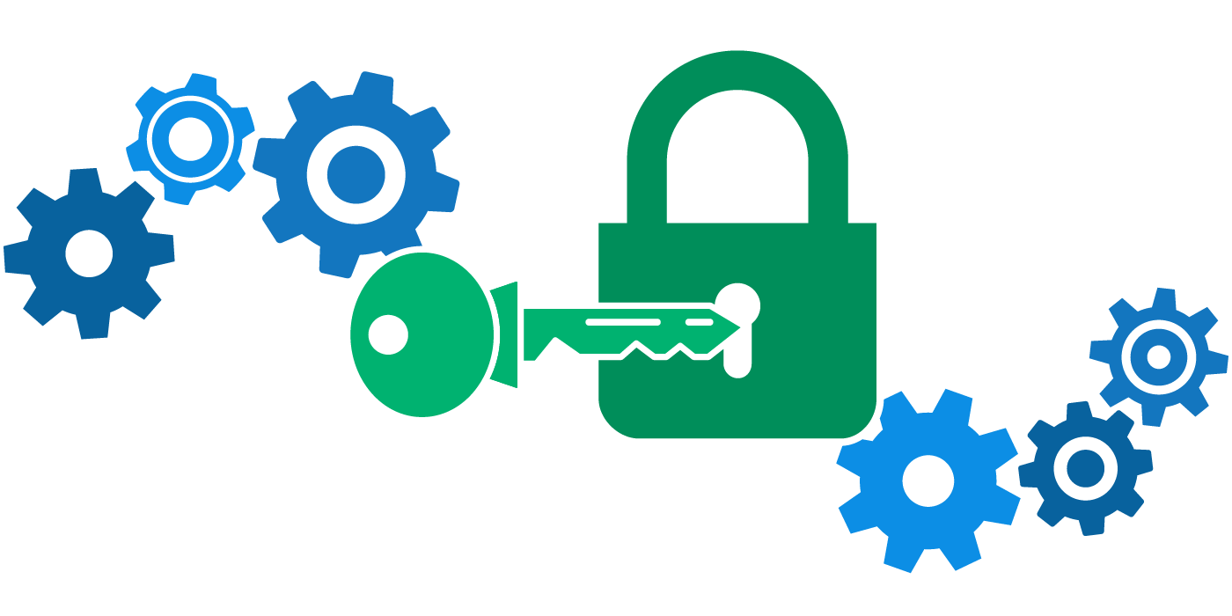

Encryption -> the left, right and what's left
By
Nitin Ramesh

Slide 2
What is Encryption?
Process of encoding particular information so that authorized parties with the correct key can decode and view that information.

Slide 3
Symmetric Encryption
Shared Key Encryption
Ex: DES, 3DES, AES, and RC4
Asymmetric Encryption
Public & Private Key Encryption
Ex: RSA

Slide 4
What is a Socket?
IP Address + Port Number

Slide 5
What is a SSL/TLS?
Standard security protocol for establishing encrypted links between a web server
and a browser in an online communication
Notes:
Links to read:
TLS standard document
https://www.ietf.org/rfc/rfc5246.txt

Slide 6
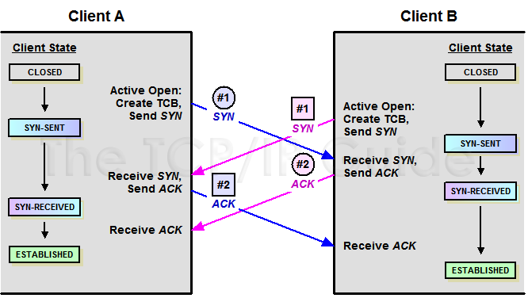
TCP Handshake

Slide 7
TLS Handshake

Slide 8







Request encrypted session + supported ciphers
Agreed Ciphers Suite type + Certificate (with public key)
+
Verify certificate + create symmetric key & encrypt with public key
+
=
Acknowledges successful activation of symmetric key
+
ACK
Secured Connection established

Slide 9
Cipher Suites
Notes:
http://www.thesprawl.org/research/tls-and-ssl-cipher-suites/

Slide 10
What is a Cipher?
A cipher is a technique/method of encrypting text.
Involves an algorithm that ciphers data and a key which defines the method of ciphering.

Slide 11
Block Cipher
Considers a whole block
Ex: DES, AES etc.
Stream Cipher
Considers one bit at a time
Ex: RC4, WAKE, Phelix etc.

Slide 12
Block Cipher
Applied to a block of data (for example, 64 contiguous bits) at once as a group rather than to one bit at a time
Consists of 2 pairs of algorithms: E -> Encryption & D -> Decryption
Input
Output
Block of ‘n’ bits size
Key - > K
Cipher Block of ‘n’ bits size

Slide 13
#Big Thing Alert 1

Slide 14
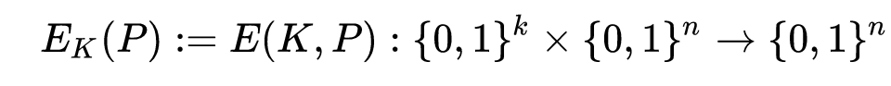
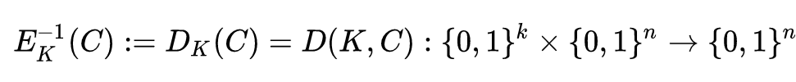
Encryption
= C
K -> Key used in the encryption process.
k -> Length of the key used in the encryption process.
P -> Info String (Block to be ciphered).
n -> Length of the block.
C -> Cipher block of ‘n’ bits.
Decryption
E = T(D)
= P

Slide 15
Stream Cipher
(a.k.a State Cipher)
Applied to one bit of data at a single go, as a group rather than consider a block at a time.
Faster and less hardware intensive. 2 types ->Synchronous stream ciphers & Self synchronous stream ciphers
Input
Output
‘n’ bits of information
Key - > K
Cipher Block of ‘n’ bits size
Notes:
In a synchronous stream cipher a stream of pseudo-random digits is generated independently of the plaintext and ciphertext messages, and then combined with the plaintext (to encrypt) or the ciphertext (to decrypt).
Another approach uses several of the previous N ciphertext digits to compute the keystream. Such schemes are known as self-synchronizing stream ciphers, asynchronous stream ciphers or ciphertext autokey (CTAK).

Slide 16
What is a Cipher Suite?
A cipher suite is a set of algorithms that help secure a network connection
that uses Transport Layer Security (TLS) or Secure Socket Layer (SSL).

Slide 17
Cipher Suite
Key Exchange
Algorithm
Bulk Encryption Algorithm
Message Authentication Algorithm
Key Exchange Algorithm: Method by which cryptographic keys are exchanged between 2 parties to use a crypt algorithm.
Bulk Encryption Algorithm: Algorithms that encrypts & decrypt all the traffic at the either ends of the communication lines.
Message Authentication Algorithm: Short piece of information used to authenticate a message. (Verification Hashes)
Notes:
Key exchange is done either in-band or out-of-band. In in-band key exchange, keys are exchanged through the same communication channel that will be encrypted. In out-of-band key, keys are exchanged through a channel else than the one that will be encrypted.^{[1]}

Slide 18
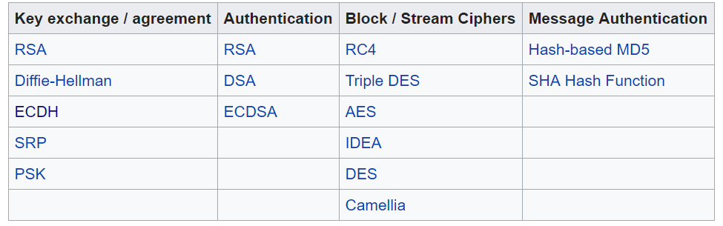
Cipher Suite Breakdown
Notes:
GCM and CBC modes internally work quite differently; they both involve a block cipher and an exclusive-or, but they use them in different ways.
In CBC mode, you encrypt a block of data by taking the current plaintext block and exclusive-oring that wth the previous ciphertext block (or IV), and then sending the result of that through the block cipher; the output of the block cipher is the ciphertext block.
GCM mode provides both privacy (encryption) and integrity. To provide encryption, GCM maintains a counter; for each block of data, it sends the current value of the counter through the block cipher. Then, it takes the output of the block cipher, and exclusive or's that with the plaintext to form the ciphertext.
https://crypto.stackexchange.com/questions/2310/what-is-the-difference-between-cbc-and-gcm-mode

Slide 19
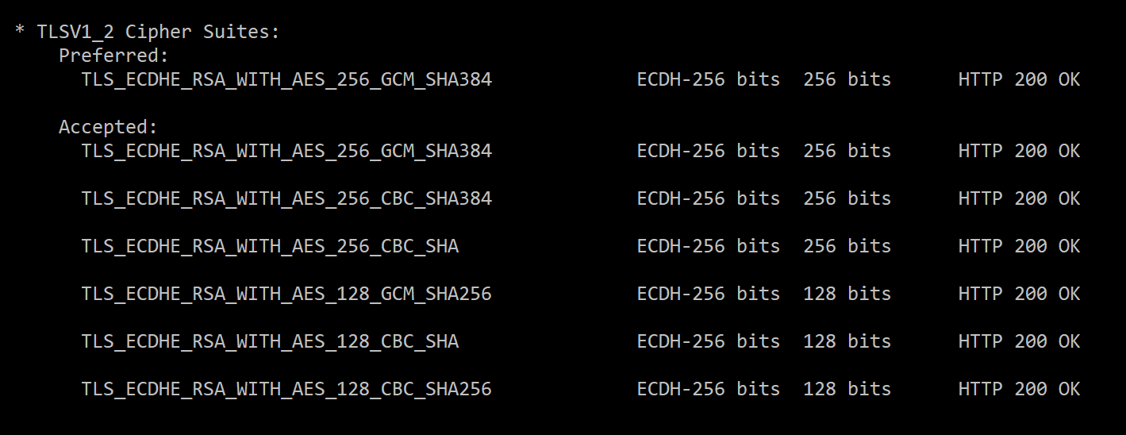
Cipher Suite Block

Slide 20
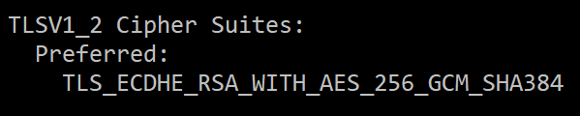

Slide 21
Same Algorithms But different Ciphers Suites?
Added protection against cipher-block chaining (CBC) attacks.
The implicit initialization vector (IV) was replaced with an explicit IV.
Change in handling of padding errors.
Support for IANA registration of parameters.
TLS v1.0 -> TLS v1_1
Notes:
The difference between the different version is that , the algorithms are just encrypting functions that work on a particular block of data.
But the technique of how it works has been changed, such as amount of data in a block, the IV, the handshake mechanism, error handling mechanisms etc.
An initialization vector (IV) or starting variable (SV) is a block of bits that is used by several modes to randomize the encryption and hence to produce distinct ciphertexts even if the same plaintext is encrypted multiple times, without the need for a slower re-keying process.
https://en.wikipedia.org/wiki/Transport_Layer_Security
https://www.ibm.com/developerworks/community/blogs/f8c3fa11-2d6e-46c3-b4ab-d3899aa84ac7/entry/what_are_the_major_security_updates_in_tls_v1_2_versus_previous_tls_protocol_versions9?lang=en

Slide 22
TLS v1_3 Cipher Suite
New cipher-suites only available in 1_3.
Removing support for MD5 and SHA-224 cryptographic hash functions
Requiring digital signatures even when a previous configuration is used
Prohibiting SSL or RC4 negotiation for backwards compatibility
Notes:
https://www.openssl.org/blog/blog/2017/05/04/tlsv1.3/

Slide 23
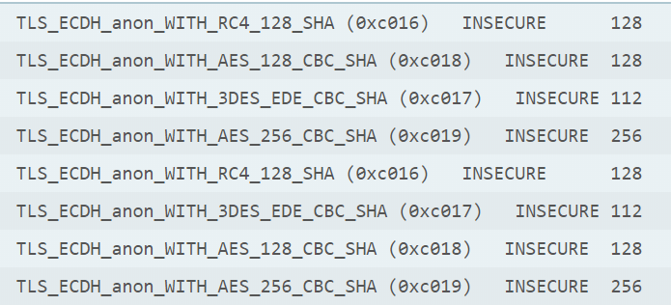
Anonymous Ciphers
Generally provides for confidentiality without the need for a certificate authority.
That means, doesn’t need a certificate.
Provides encryption without authentication.
Highly vulnerable to MIM attacks.

Slide 24
112 bit ciphers
Notes:
https://security.stackexchange.com/questions/180012/are-ciphers-with-a-strength-of-112-bits-considered-weak

Slide 25

Vulnerable Algorithms
Notes:
https://www.youtube.com/watch?v=5IchxMA4caQ
https://www.youtube.com/watch?v=-6wFSA5calk

Slide 26
Vulnerable Algorithm I - RC4
Stream Cipher
Used in popular security mechanisms like WEP/WPA (Wired Equivalent Privacy).
Used in ARC4Random number generator.
SSL (Secure Socket Layer)/TLS (Transport Layer Security)
Microsoft’s RDP (Remote Desktop Protocol)
BitTorrent
Notes:
https://www.rc4nomore.com/vanhoef-usenix2015.pdf
Exploit: https://youtu.be/d8MtmKrXlKQ
RC4 contains several known weaknesses. In particular, an attacker that can gather a large number of ciphertexts that contain the same plaintext encrypted using different keys may be able to recover the plaintext (the typical target of this attack would be a cookie that is sent in multiple SSL/TLS sessions).

Slide 27
RC4 - Attacks
IV weakness
RC4
Bar Mitzvah Attack
Notes:
https://www.imperva.com/docs/HII_Attacking_SSL_when_using_RC4.pdf
https://www.blackhat.com/docs/asia-15/materials/asia-15-Mantin-Bar-Mitzvah-Attack-Breaking-SSL-With-13-Year-Old-RC4-Weakness-wp.pdf

Slide 28
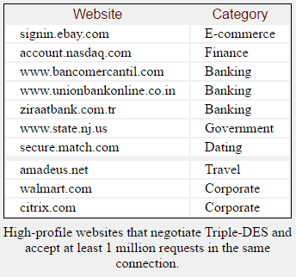
Vulnerable Algorithm II - DES
NSA Approved Block Ciphers
Superseded by the Advanced Encryption Standard (AES)
DES uses a 56-bit key = 72,057,594,037,927,936 combinations
Average of 23 hours to crack.
Notes:
Although now considered insecure, it was highly influential in the advancement of modern cryptography.

Slide 29
Vulnerable Algorithm III – 3DES
Triple DES uses -> three DES keys, K1, K2 and K3, each of 56 bits
ciphertext = EK3(DK2(EK1(plaintext)))
DES encrypt -> K1, DES decrypt -> K2, then DES encrypt -> K3.
Decryption:
plaintext = DK1(EK2(DK3(ciphertext)))
DES decrypt -> K3, encrypt -> K2, then decrypt -> K1

Slide 30
Sweet 32 Attack
The DES ciphers (and triple-DES) only have a 64-bit block size.
Need to run JS on browser -> capture 32 GB of data from single session.
Payload to generate a large amounts of traffic during the same TLS connection, creating a collision.
With this collision, the attacker is able to retrieve information such as a session cookie.
Notes:
Collision attack : Find two different messages m1 and m2 such that hash(m1) = hash(m2).

Slide 31
Vulnerable Algorithm – III - Remaining
DES, 3DES, MD5, Sha1, AES, Blowfish, Diffie Hellman

Slide 32
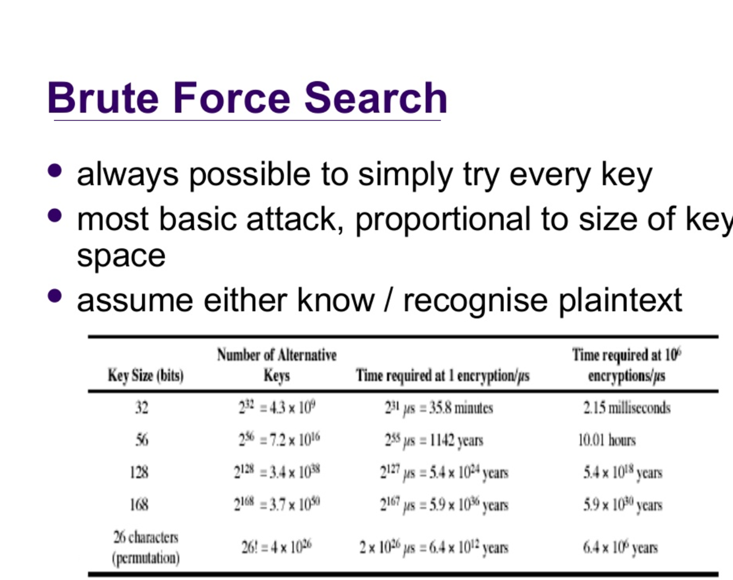

Slide 33
Attacks on Algorithms

Slide 34
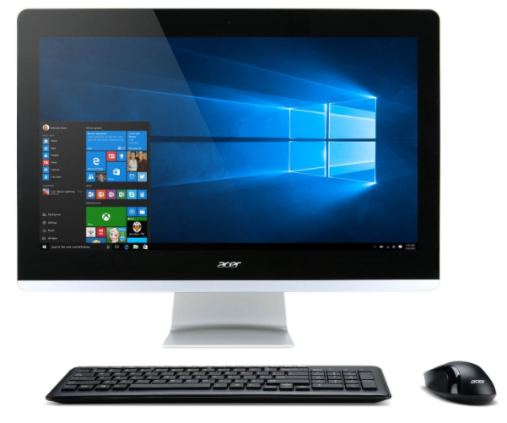
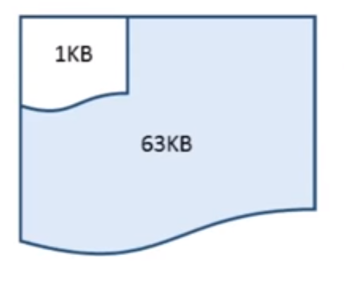
Heartbleed Attack
Heart Beat is when one computer checks if the other computer listening is still “awake”.
No sensitive info so usually not encrypted. Usually around 1 kb of data, upto 64kb.
Send 1kb of data and tell its 64kb instead. Do it multiple times in a single instant.
Empty
Notes:
1kb is responded with 1kb & 64kb with 64 kb.
Update to 1.0.1g
-DOPENSSL_NO_HEARTBEATS option.

Slide 35
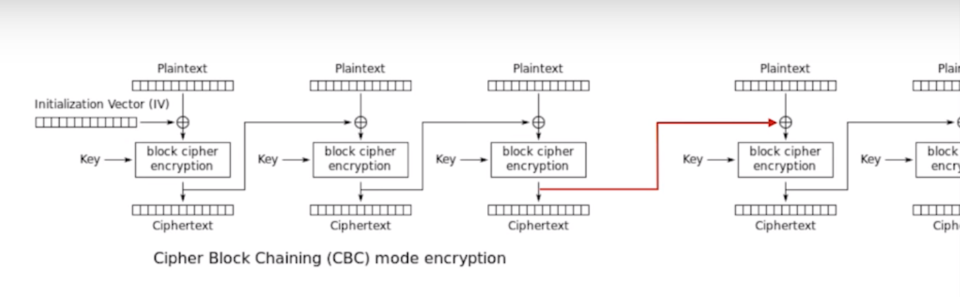
BEAST Attack
BEAST -> Leverages weakness in CBC -> Exploits the SSL.
Targets the use of repeated IV(s) -> Initialization vectors.
More of a proof of concept.
Requires JavaScript interception to increase request capture.
Notes:
https://www.youtube.com/watch?v=-_8-2pDFvmg&t=215s

Slide 36
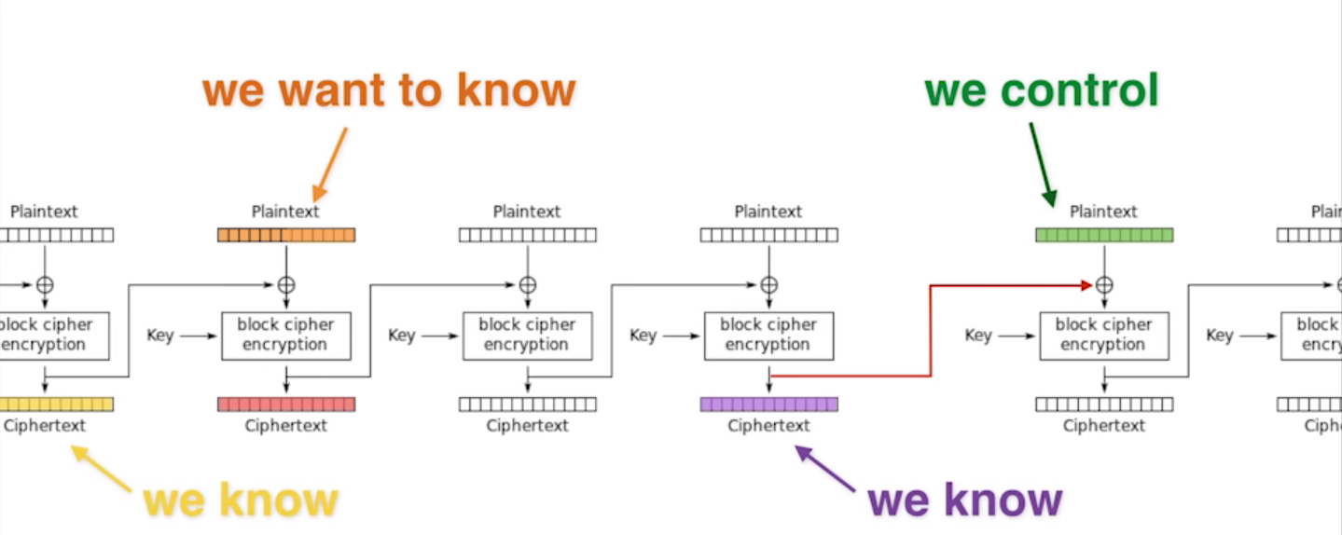
Notes:
The IV is reused in the next block.
Also the previous last cipher block is used as plain text for the next block.
We are not interested in this , but we can detect the patterns and we know the IV(s).
Google inserted a plain empty message btw the cipher block , so that the cipher block is not reused.
Finally mitigated by use of TLS 1.1/1.2

Slide 37
POODLE Attack
Force the backend, by supporting only SSLv3 and rejecting the TLS connections
Need to make 256 SSL 3.0 requests to reveal one byte of encrypted messages
Message
MAC
PADDING
Uses CBC mode -> The encrypted block process is incorporated in to the next block.
Mitigation: Upgrade from SSLV3 and set the TLS_FALLBACK_SCSV to prevent fallback to SSLv3.
Essentially, TLS_FALLBACK_SCSV allows clients to send a hidden version number in the downgraded connection attempt in a way that doesn't trigger the server bugs.
Notes:
TLS fallback when we force the backend TLS connections to fail so that it will fall back to SSLv3
After decryption, the recipient looks at the last block which is the padding & knows how much padding to remove.
Knows after the padding is the MAC value, if MAC = OK, then data is good to take.
Else the message is dropped.
Change the message for some sensitive info, the recipient will knows its wrong as its checking the wrong bytes for the MAC and drop it.
But some times, he gets lucky and the padding will match, he knows this, because the recipient didn’t drop it and send a message saying this is wrong data.
Now that he knows the encrypted block with was sent and the padding he can derive the last byte of the message due to its structural weakness in the algorithm.
https://www.youtube.com/watch?v=krAG2YtutnQ

Slide 38
Renegotiation

Slide 39
What is a Renegotiation?
Starting a new handshake negotiation inside of an existing secure session
is called renegotiation.

Slide 40
Client Initiated Renegotiation
The client side is allowed client to renegotiate new encryption parameters
for an SSL/TLS connection within a single TCP connection.
Handshakes usually involve a high degree of computational overhead.
Done via a single thread is not very effective.
But done over a distributed platform over a elongated period leads to DOS attacks.
Use Rate limiters or don’t support this method.
Notes:
Usually CIR is done when client has to give his certificate to access selected resources?

Slide 41
Insecure Renegotiation
A flaw in the design of the handshake process of SSL/TLS allows an attacker to inject arbitrary data into the beginning of a client's communication with a server during a man-in-the-middle attack.

Slide 42


Forwards all the requests to and from
Client Handshake request
intercepted
Initiates TLS connection + Payload injected
Payload
Initiates Renegotiation
Send intercepted Client handshake request
Handshake successful + Encrypted connection start
1st Sensitive Operation data sent to the Server
Sensitive Operation + Payload
Payload successful and response sent back

Slide 43
TLS - Certificates
Notes:
https://www.owasp.org/index.php/Transport_Layer_Protection_Cheat_Sheet

Slide 44
What is a certificate?
Identification passed during a handshake to verify the website the
browser is trying to connect to .

Slide 45
Certificate Validation Procedure
Step 1: Check public key and parameters.
Step 2: Check current date/time against validation period.
Step 3: Check revocation status in the CRL.
On-hold : Private key compromised
Revoked : Error/ misuse
Step 4: Checks the name constraints in the certificate.
Step 5: The path length is checked to ensure that it does not exceed any maximum path length
Step 6: The key usage extension is checked to ensure that is allowed to sign certificates
Notes:
https://www.entrust.com/wp-content/uploads/2013/05/pathvalidation_wp.pdf

Slide 46
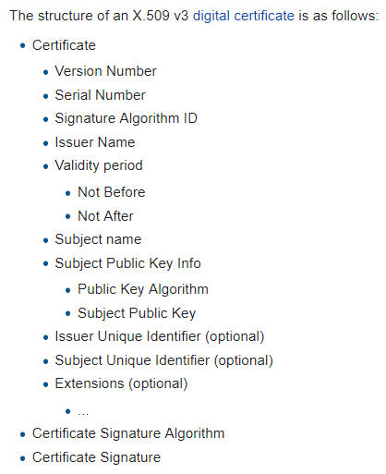
X.509 Certificates
Standardized way of generating and validating certificates.
Certificates confirm the identity of a service.
Self-Signed Certificate is an identity certificate that is signed by the same entity whose identity it certifies.
Notes:
https://www.globalsign.com/en/blog/what-is-common-name-mismatch-error/
Self signed cert: This term has nothing to do with the identity of the person or organization that actually performed the signing procedure. In technical terms a self-signed certificate is one signed with its own private key.

Slide 47

Certificates related vulnerabilities
X.509 Certificate About to Expire (SSL/TLS)
Its about to be invalidated, so renew it
X.509 Certificate Expired (SSL/TLS)
Its gone, pay the company again for a new one.
X.509 Certificate Not Yet Valid (SSL/TLS)
Will work some day.
X.509 Certificate with Wrong Hostname (SSL/TLS)
Who programmed this? Its made for a site with a different host name.
X.509 Certificate Chain Contains RSA Keys Less Than 2048 Bits (SSL/TLS)
According to industry standards, certificates issued after January 1, 2014 must be at least 2048 bits.
Literally everything required to make a proper certificate:
https://www.cabforum.org/wp-content/uploads/Baseline_Requirements_V1.pdf
Notes:
https://www.globalsign.com/en/blog/what-is-common-name-mismatch-error/
Self signed cert: This term has nothing to do with the identity of the person or organization that actually performed the signing procedure. In technical terms a self-signed certificate is one signed with its own private key.

Slide 48
TLS - Enforced/Enabled
Notes:
https://www.owasp.org/index.php/Transport_Layer_Protection_Cheat_Sheet

Slide 49
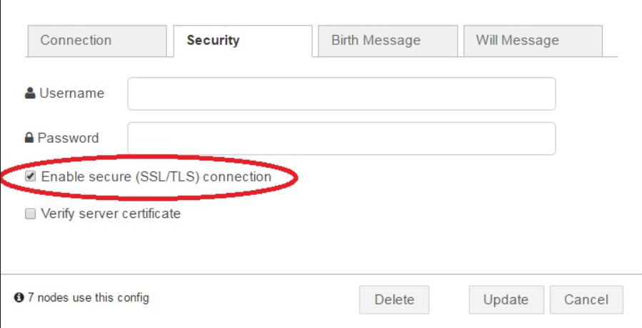

Helpful to click this link in the configuration.

Slide 50
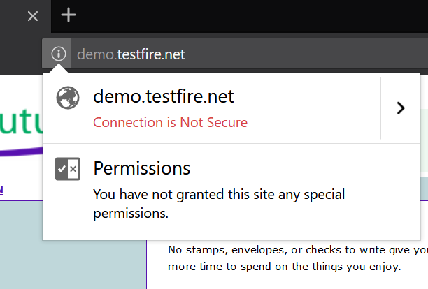
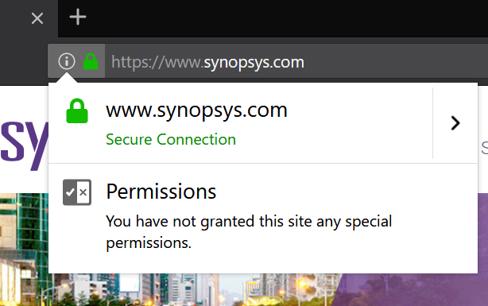
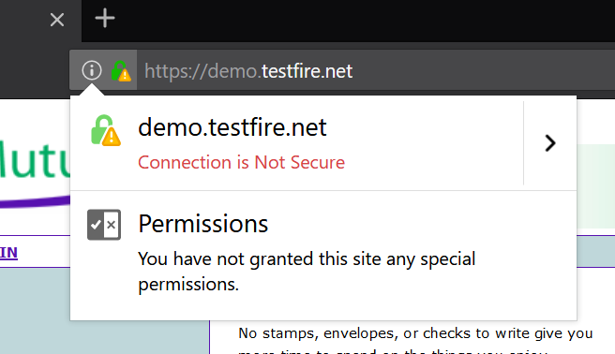
1
2
3

Slide 51
Thank you

